Slide 1
A Predictive House Sales Price Model
For Ames, IA

Slide 2
Cleaning and Exploration
What are we working with exactly?
2051 houses, each with roughly 81 attributes
Are all these attributes applicable though...

Slide 3
Cleaning: Searching for nulls
Attributes missing more than 15% :
Lot Frontage: 16.0897
Alley: 93.1741
Fireplace Qu: 48.7567
Pool QC: 99.5612
Fence: 80.4973
Misc Feature: 96.8308

Slide 4
Investigating High Null Columns
No background information explaining what a null value could or couldn’t mean.
misc_feature (miscellaneous feature) include:
Shed, TenC, Gar2(second garage), Othr(other), Elev(elevator)
Too varied, not generalizable
lot_frontage (length in feet of street connected to property):
Low amount of missing data, compare to similar lots and fill with mean

Slide 5
Exploration:
Correlation and Linearity
1: Use heat map to spot redundant attributes:
Two most notable:
basement square footage correlation with first floor square footage is 0.82
garage cars to garage area is 0.90
2. Check correlation of attributes to only sales price (see next slide)

Slide 6
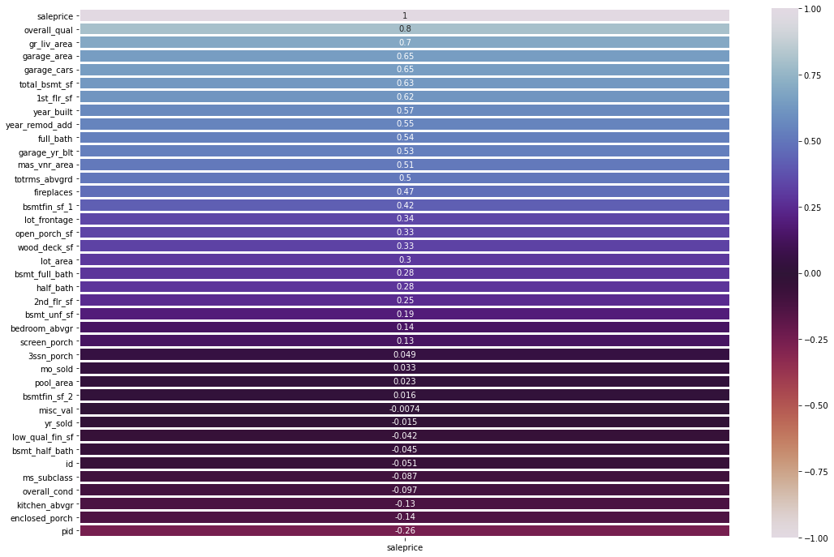

Slide 7
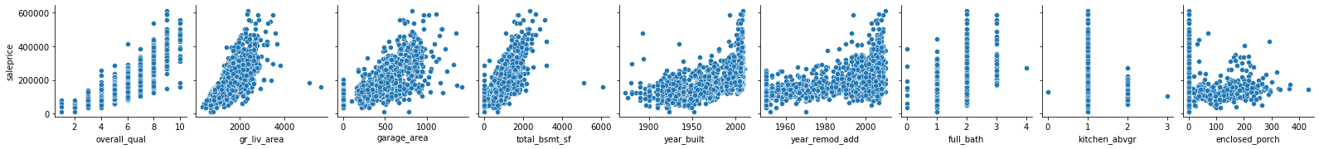
Building a Features List
From the highly correlated, positive & negative

Slide 8
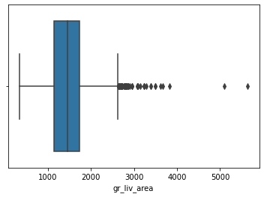
Outliers of note?
Drop to avoid skewed results

Slide 9
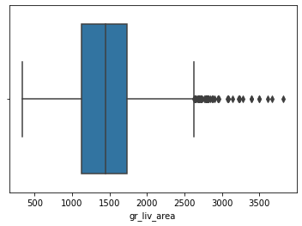
Post outliers

Slide 10
Modeling
What? A standard scaler, linear regression model
Why?
Standard Scaler to find a commonality for graded and measured attributes ex. number of rooms to area
Linear Regression selected features have linear relationships with sales price

Slide 11
Results - how is the model learning?
86.35% accuracy for testing data to 83.93% accuracy for training data
moving from the norm by 2.7%

Slide 12
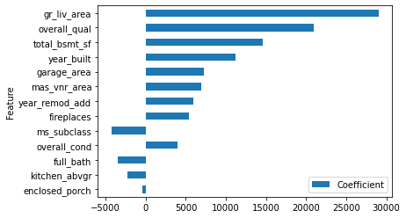
Check Coefficients
how well to they signal sales price
Coefficients by Absolute Value

Slide 13
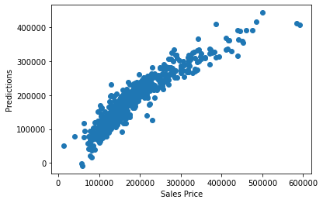
Compare Sales Price to Predicted Price

Slide 14
Conclusion

